Slide 1
Market Reactions to SPAC vs. Traditional Mergers
Evidence from an Event Study of Target Firms
FIN 309 RESEARCH SEMINAR IN FINANCE
By Team 2 Pengyu Wang · Zoe · Harish · Guy

Slide 2
Do SPAC Mergers Generate Different Market Reactions than Traditional Mergers
SPACs: faster, more flexible, less regulated
Traditional M&A: established, scrutinized, slower

Slide 3
What is SPAC?
A SPAC, or Special Purpose Acquisition Company, is a publicly traded shell company created specifically to acquire or merge with a private company, effectively taking it public without going through a traditional IPO.

Slide 4
Research Gap
Little focus on target firms’ stock performance, especially comparing SPAC and non-SPAC acquirers
Few studies compare SPAC vs. traditional mergers from the target’s perspective.
Do target firms experience different stock reactions when acquired by SPACs?

Slide 5
Hypotheses
H1a: SPAC targets experience higher positive ARs than traditional merger targets
H1b: SPAC targets experience lower positive ARs due to concerns about quality/transparency

Slide 6
Objective & Data Summary
This study investigates Compare market reaction to SPAC vs. traditional mergers
Sample: 271 mergers from 2010–2024
137 SPACs, 134 non-SPACs
Data includes:
Announcement date
Deal value
Firm financials (e.g., total assets)

Slide 7
Method – Event Study
Model: Market model using CRSP Value-Weighted Index
Software: WRDS Eventus
Event windows:
(0,0), (0,+1), (0,+2), (0,+3), (–1,0), (+1,+10)
Estimation window: 250 trading days, ending 50 days before event date
Cumulative Abnormal Returns (CARs) are computed as the primary outcome variable

Slide 8
T-Test & Regression Framework
We compare CARs between SPAC and traditional acquirers using two-sample t-tests
We run OLS regressions using SPAC dummy, deal value, TASS, year effects
Extended model includes profitability and market-to-book ratio

Slide 9
Event Study and Regression Results
This section presents our main findings using event study, t-tests, and regressions.
CARs calculated over six event windows.
Results show distinct short-term reactions to SPAC vs traditional mergers.

Slide 10
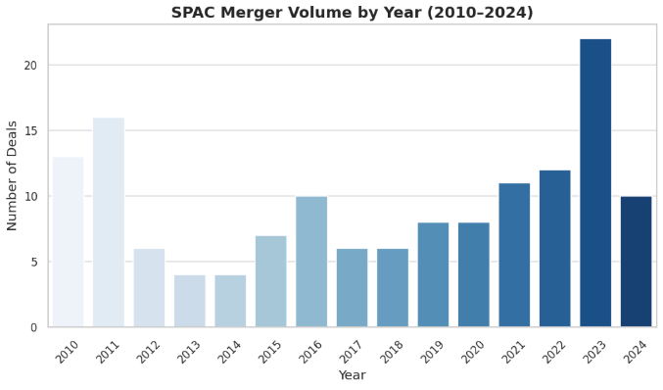
SPAC Deal Volume by Year (2010–2024)
Deal activity rose post-2015.
Peak: 2023 = 22 deals (15.38%)
Drop in 2024 likely due to regulatory tightening.

Slide 11
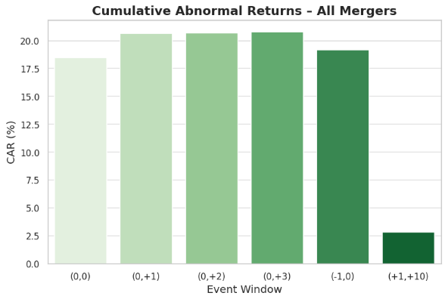
CARs Across All Mergers
All event windows show positive and significant abnormal returns.
Highest CAR: (0, +3) = 20.81%, t = 10.114***
(+1, +10) still positive: 2.82%

Slide 12
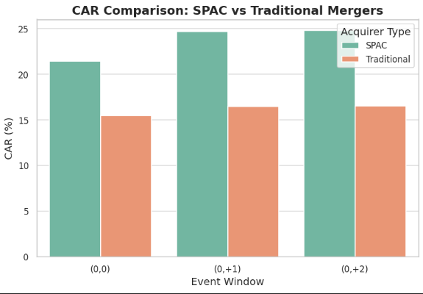
CAR Comparison: SPAC vs Traditional Mergers
SPACs had higher CARs in all windows.
Example: (0, +2) → SPAC = 24.77%, Traditional = 16.55%
Significant differences in (0, +1) and (0, +2)

Slide 13
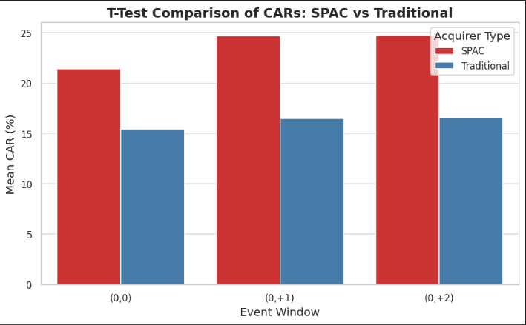
T-Test Comparison of CARs: SPAC vs Traditional
Clearly shows higher CARs for SPACs
Largest gap in (0,+2) = 8.22%
Statistical significance mentioned in paper for (0,+1) and (0,+2)

Slide 14
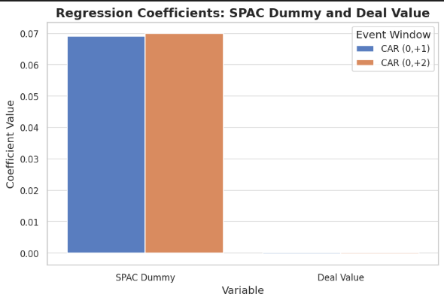
Regression Results: Basic Controls
SPAC dummy = positive & significant in (0, +1), (0, +2)
Example: (0, +2) → +0.070*
Deal value = negative & significant
Target asset size = not significant

Slide 15
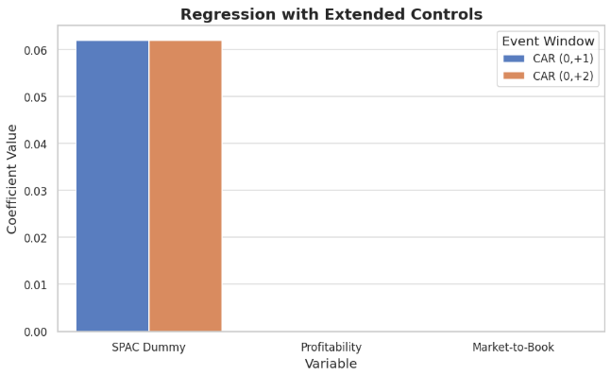
Regression: Extended Controls
SPAC dummy remains significant: +0.062* in both key windows
Profitability & Market-to-Book ratio = not significant
Effect of deal value persists

Slide 16
Main Finding
SPAC mergers lead to higher short-term abnormal returns (CARs) for target firms, compared to traditional mergers.
In the (0, +2) window, SPAC targets had a mean CAR of 24.77%, while regular mergers had only 16.55%.
That’s a difference of more than 8 percentage points.

Slide 17
Why Does This Matter?
It shows that investors may prefer SPAC structures in the short term.
Because SPACs are faster, more flexible, and less regulated.
That creates more room for negotiation and faster access to capital.
Helps investors and analysts compare risk and return.
If someone focuses on short-term profits, investing in SPAC targets might be a better choice.

Slide 18
Limitations of Our Study
First, we only looked at short-term market reactions. We did not analyze long-term performance, so we don’t know if SPAC targets continue to do well over time.
Second, we didn’t control for SPAC sponsor quality. Some sponsors are very experienced and well-known — others are not.
Third, we didn’t explore industry differences.A tech firm and a healthcare firm may have very different stock reactions — but we treated all industries the same in this version of the study.

Slide 19
Future Research Directions
Going forward, researchers can explore several things:
Longer-term returns: What happens to SPAC targets 1 or 2 years after the merger?
Cross-country comparisons: Are results similar in Europe or Asia?
More detailed SPAC characteristics: Like redemption rates, sponsor background, or the industry of the target firm.

Slide 20
Thank You – Questions?

